Slide 1
Pheno_opt_rice
Brief introduction by Pepijn van Oort

Slide 2
Problem statement
In a number of studies it was found that temperature sum increased over time or that systematic errors occurred in the prediction of the duration of the developmental phase from emergence to flowering in hot or cold environments
This is problematic because it results in less accurate predictions. But also the consequence is that models cannot be used to address questions such as what will be the impact of temperature increase (climate change?) and can the possible area where this crop is cultivated expand into cooler areas
The objective was to find one set of parameters for phenology prediction with which such systematic errors were eliminated.

Slide 3
Our solution
A calibration program with which not only the temperature sum is calculated over experiments in a range of environments (normal practice) but simultaneously also all the other phenology parameters (new).
The following slides show observed and predicted duration from emergence to flowering (y-axis) versus average air temperature during this period.
With default cardinal temperatures, the model predicts too short duration at low growing season temperatures and too long duration at high growing season temperatures. See the red circles
The next slide shows that with optimised parameters, quite different from the default, such systematic errors no longer occur.
The x-axis also provides a rough estimate of the temperature range in which the model is calibrated and therefore valid.

Slide 4
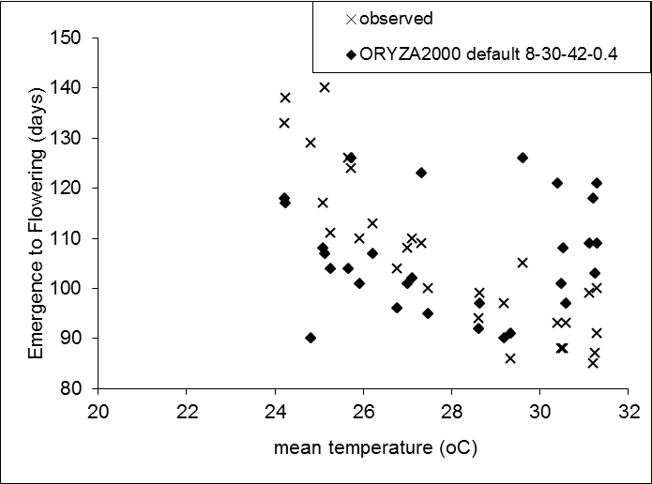
Rice phenology default (8 – 30 – 42 oC)

Slide 5
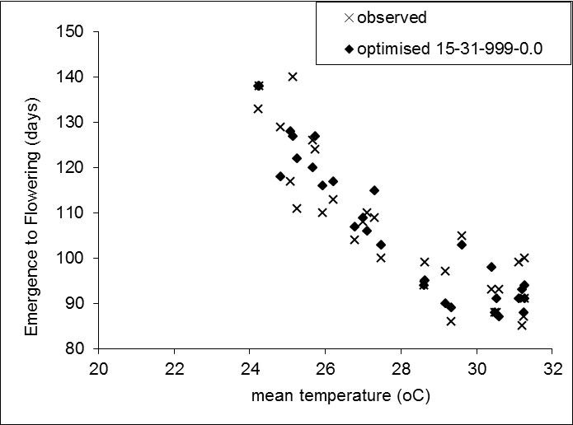
New Rice phenology calibration program !

Slide 6
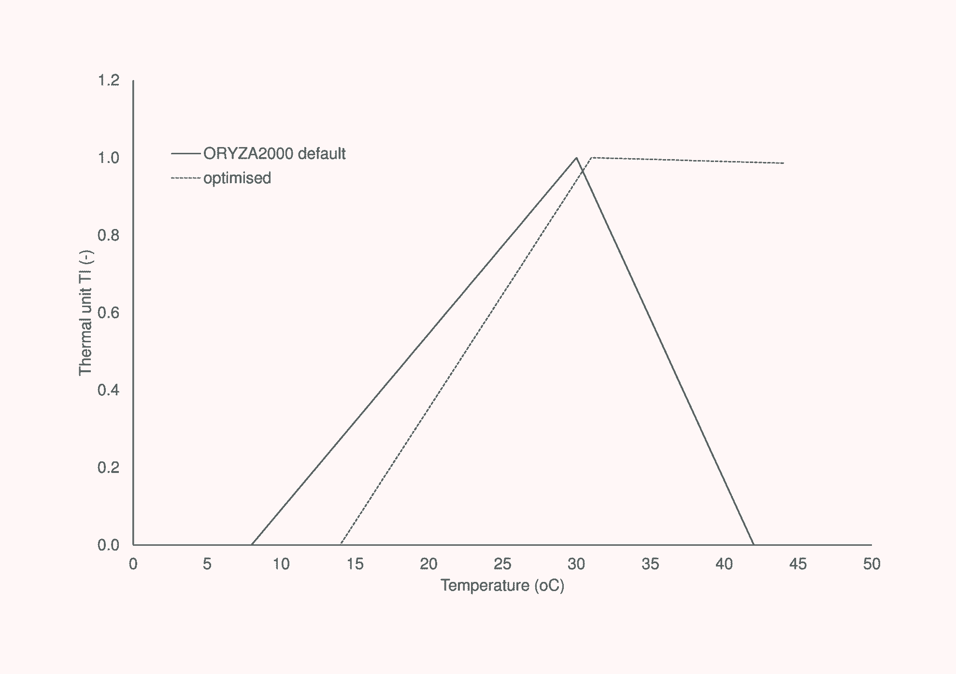
Rice phenology: temperature response

Slide 7
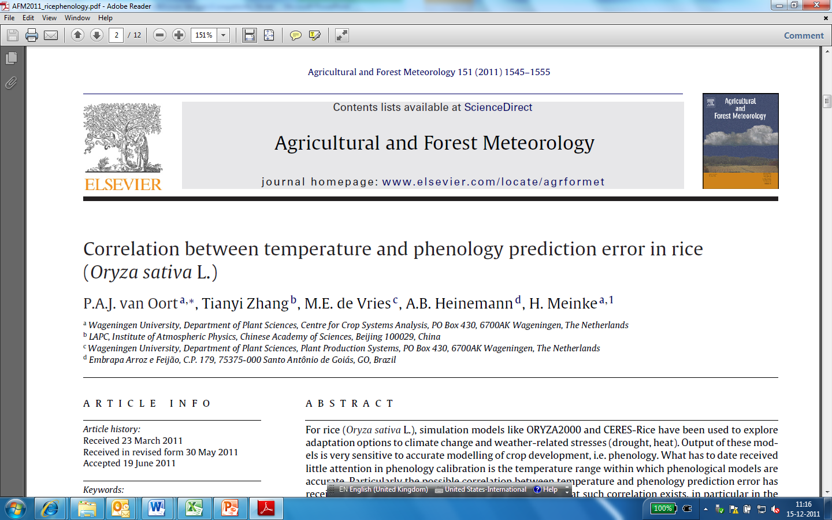

Slide 8
Conclusions
Predicting a too long rice season at high temp (>29oC)
Predicting a too short rice season at low temp (<25oC)
After optimisation no more bias
Optimised parameters quite different: base temperature 15oC (default 8oC) and maximum 999oC (default 42oC) and slightly higher optimum (31 vs 30oC)
Important to report temperature range in which calibrated
Further testing needed in other environments

